Slide 1
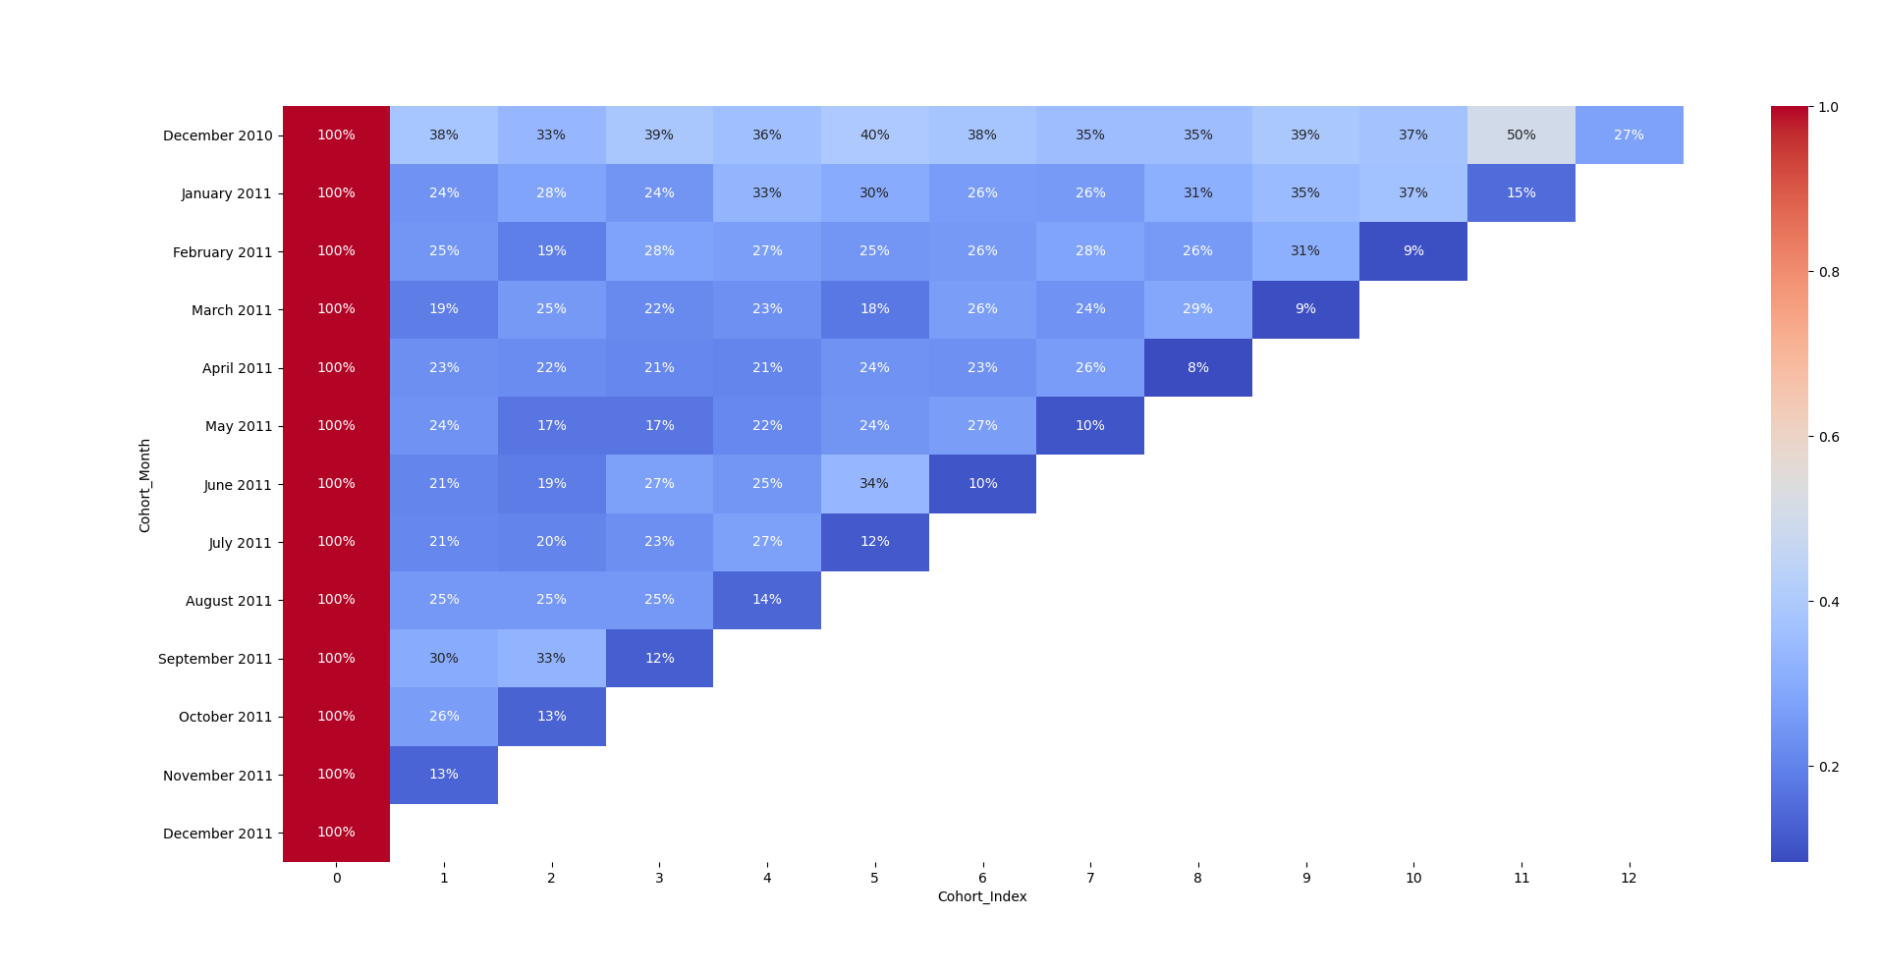
50%
customers acquired in December 2010 are still active 11 months later

Slide 2
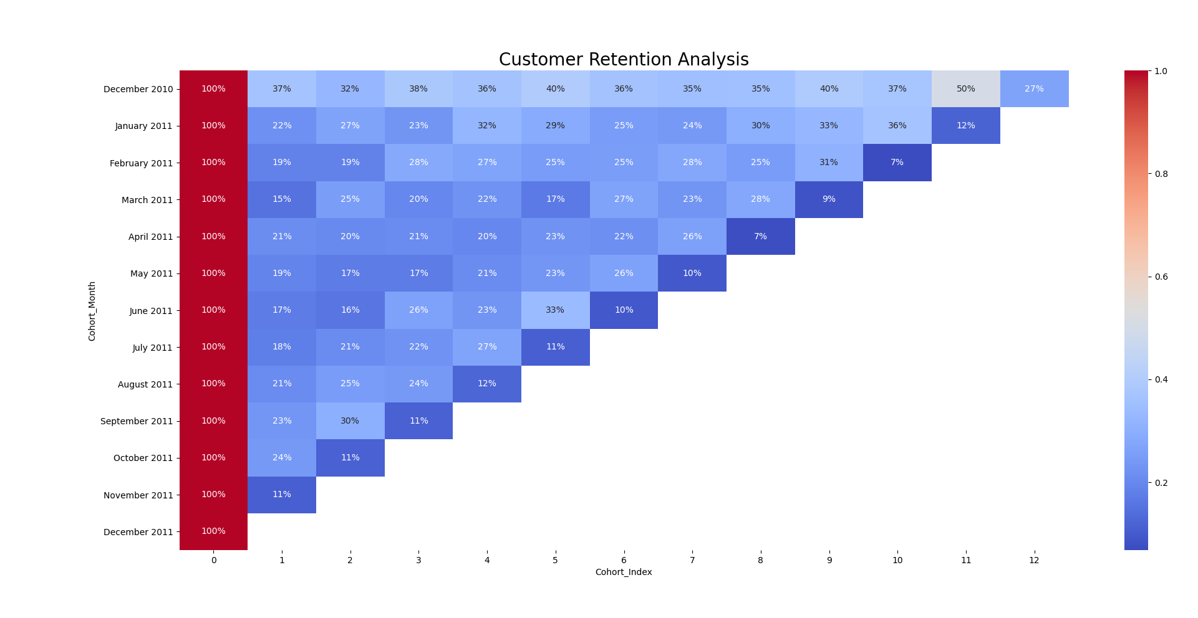
50%
of customers acquired in December 2010 were still active 11 months later

Slide 3


A/B Testing
VS
Variation 1
Conversion 12%
Variation 2
Conversion 11%

